Slide 1
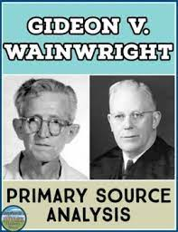
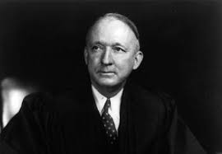
Gideon v. Wainwright (1963)
Issue: Does the Constitution require that any individual charged with a felony, but unable to pay for a lawyer, be guaranteed the free assistance of legal counsel? Result: Yes, according to a unanimous Supreme Court. The Court held that the Sixth Amendment right to assistance of counsel applies to criminal state trials and that "lawyers in criminal court are necessities, not luxuries." Importance: Along with the right to assistance for state criminal defendants, the Gideon decision had the effect of expanding public defender systems across the country.
https://www.americanbar.org/groups/public_education/programs/constitution_day/landmark-cases/

